Slide 1
University of Basrah
College of Nursing
Fundamentals of Nursing Department
Adult Nursing (II) 2nd Stage
Lecture 11 (Theory)
Nursing Management of Patients with Ophthalmic Disorders
Prepared by
Assistant Lecturer Ali Malik Tiryag

Slide 2
Learning Objectives
On completion of this chapter, the student will be able to identify
ANATOMY OF THE EYE
HX & EX
Impaired Vision
GLAUCOMA
CATARACT

Slide 3
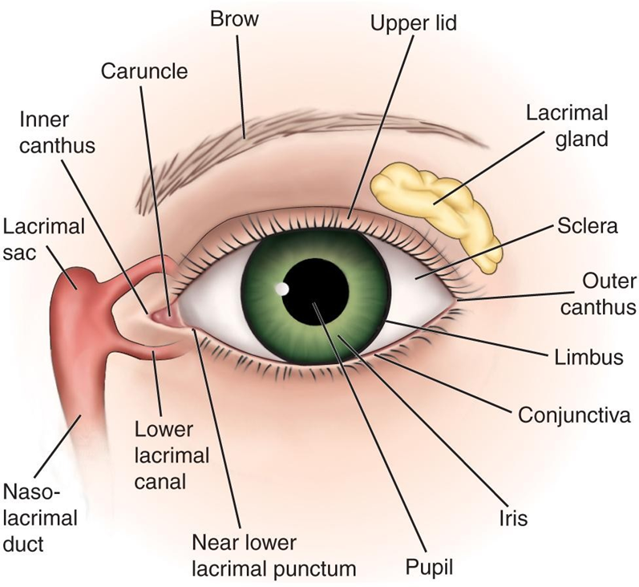
External Structures of the Eye

Slide 4
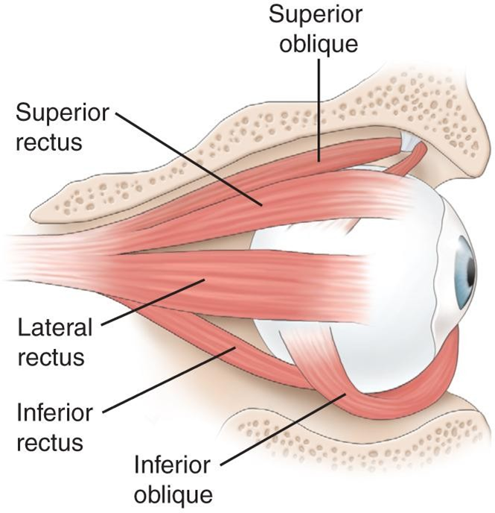
Extraocular Muscles

Slide 5
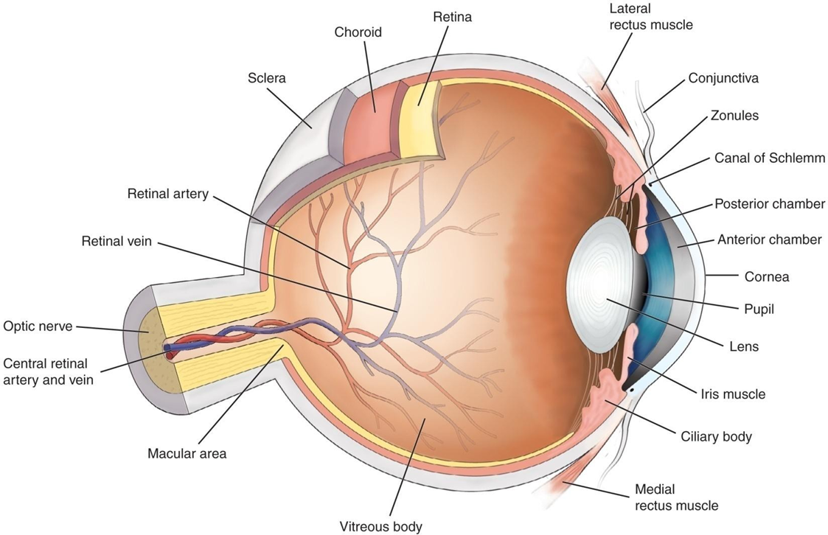
Cross-Section of the Eye

Slide 6
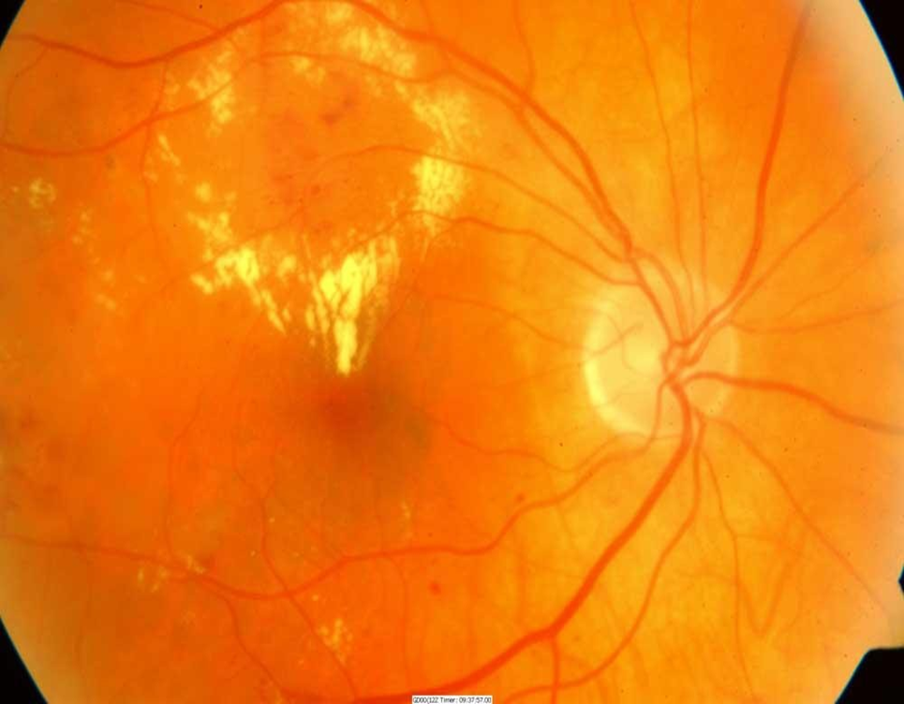
Internal Structures of the Eye

Slide 7
Assessment and Evaluation of Vision
Ocular history WHAT? WHEN? WHERE? WHY? WHAT
Visual acuity
- Snellen chart
-Record each eye
-20/20 means the patient can read the ―20 line at a distance of 20 feet
Finger count or hand motion.

Slide 8
Examination of the External Structures
Note any evidence of irritation, inflammatory process, discharge, etc.
Assess eyelids and sclera
Assess pupils and pupillary response; use darkened room
Note gaze and position of eyes
Assess extraocular movements
Ptosis: drooping eyelid
Nystagmus: oscillating movement of eyeball

Slide 9
Diagnostic Evaluation
Ophthalmoscopy
-Direct and indirect
-Examines the cornea, lens and retina
Slit-lamp examination
Color vision testing
Amsler grid
Ultrasonography
Fluorescein and indocyanine green angiography

Slide 10
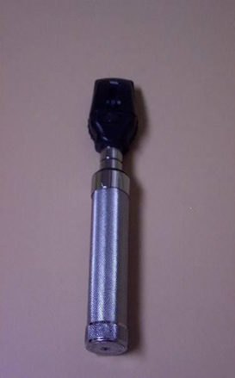
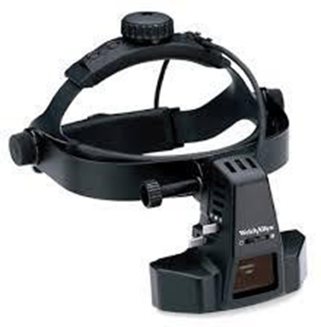
Instruments

Slide 11
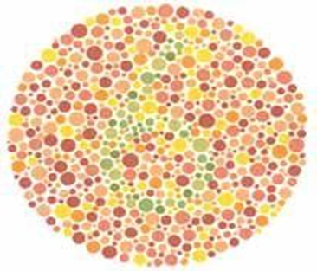
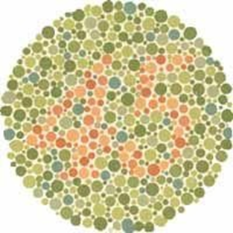
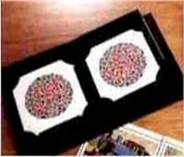
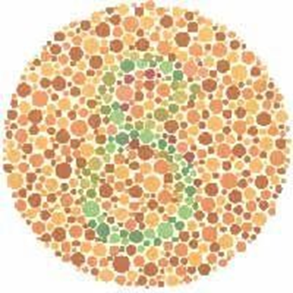
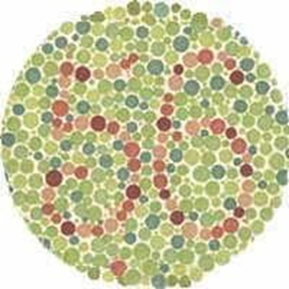
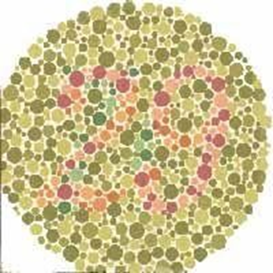
COLOR VISION

Slide 12
Diagnostic Evaluation
Tonometry
-Measures intraocular pressure
Gonioscopy
-Visualizes the angle of the anterior chamber
Perimetry testing
-Evaluates the field of vision
-Scotomas: blind areas in the visual field

Slide 13
Impaired Vision
Refractive errors
– Can be corrected by lenses that focus light rays on the retina
Emmetropia: normal vision
Myopia: nearsighted
Hyperopia: farsighted
Astigmatism: distortion due to irregularity of the cornea

Slide 14
Glaucoma
A group of ocular conditions in which damage to the optic nerve is related to increased intraocular pressure (IOP) caused by congestion of the aqueous humor
The leading cause of blindness in adults in the U.S.
Incidence increases with age

Slide 15
Glaucoma “Silent Thief of the Sight”
Is an eye disease that involves damage to the optic nerve, sometimes resulting in permanent vision loss.
It is one of the leading causes of blindness in adults over age 60. Most often glaucoma is associated with pressure build-up inside the eye.

Slide 16
▶ Normally, a fluid called aqueous humor flows around the eye. It's made up mostly of water, plus a small number of nutrients to nourish the cornea and lens. After bathing the eye, this fluid drains through an area called the trabecular meshwork in the corner where the cornea and iris meet.
▶ In glaucoma, either too much fluid is produced or it doesn't drain efficiently. The fluid builds up and causes pressure to rise inside the eye, which leads to optic nerve damage.

Slide 17
The trabecular meshwork
It is a sieve-like structure that acts as a filter between the anterior chamber and Schlemm’s canal (SC), a circular canal that collects the aqueous and evacuates it into the extraocular circulation.
The trabecular meshwork controls the IOP by regulating the outflow of aqueous humor from the anterior chamber of the eye into the adjacent Schelmm’s canal (SC) and then via aqueous vein collector channels into the venous system.

Slide 18
Types of Glaucoma
1- Open-angle glaucoma: the drainage angle formed by the cornea and iris remains open, but the trabecular meshwork is partially blocked. This causes pressure in the eye to gradually increase which leads to damage to the optic nerve.
It happens so slowly that a patient may lose vision before he’s even aware of a problem.

Slide 19
2- Angle-closure glaucoma: occurs when the iris bulges forward to narrow or block the drainage angle formed by the cornea and iris.
As a result, fluid can't circulate through the eye, and pressure increases. Some people have narrow drainage angles, putting them at increased risk of angle-closure glaucoma.

Slide 21
3- Normal-tension glaucoma:
the optic nerve becomes damaged even though the eye pressure is within the normal range.
No one knows the exact reason for this. A patient may have a sensitive optic nerve or may have less blood being supplied to the optic nerve. This may be caused by atherosclerosis or other conditions that impair circulation.

Slide 22
4- Pigmentary glaucoma
pigment granules from the iris build up in the drainage channels, slowing or blocking fluid exiting the eye.
Activities such as jogging sometimes stir up the pigment granules, depositing them on the trabecular meshwork and causing intermittent pressure elevations.

Slide 23
Risk factors
1- A family history of glaucoma
2- Age (60 and over, or age 40 and over for African Americans)
3- Increased eye pressure
4- Thin cornea
5- Very severe nearsightedness
6- Eye surgery or injury
7- High blood pressure or cardiovascular disease
8- Diabetes

Slide 24
Clinical Manifestations
Often, no symptoms appear until the optic nerve has been significantly damaged. That's why this disease is often called a “silent thief of the sight “
In its later stages, glaucoma causes blind spots to appear in the peripheral (side) and central vision.

Slide 25
Clinical Manifestations
Severe pain in the eye or forehead
Blurred or reduced vision
Nausea and vomiting
Headache
Eye redness
Halos around lights

Slide 26
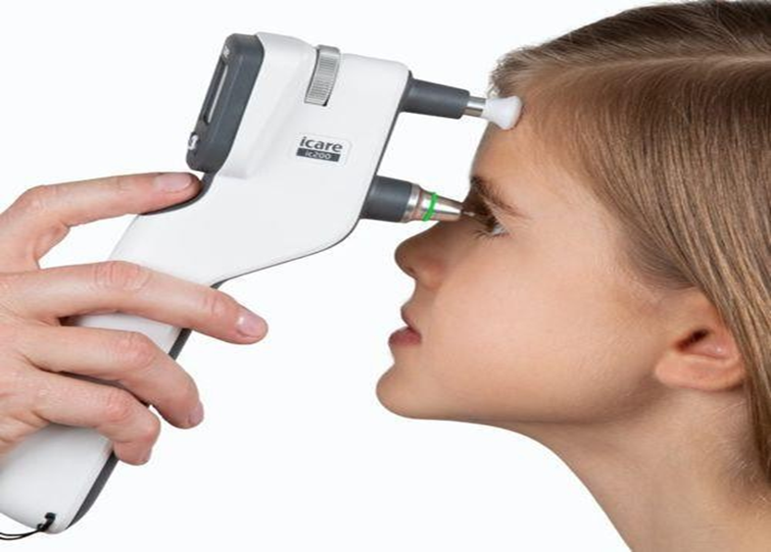
Diagnosis
Before the exam, the doctor may use eye drops to dilate (widen) and/or numb the pupils, this allows more light into the eye and makes it easier for the ophthalmologist to see.
1- Tonometry: this detects elevated IOP (>10 to 20 mmHg)

Slide 27
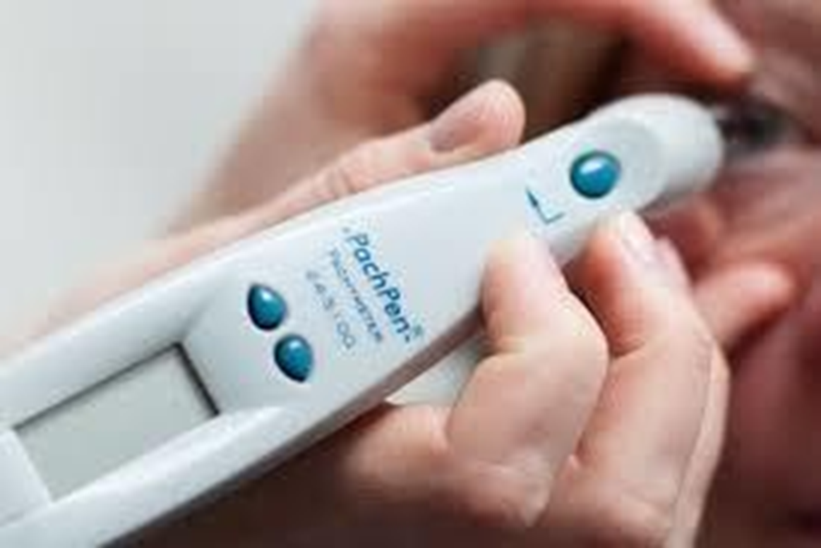
2- Pachymetry: measures the thickness of the cornea—the clear front part of the eye.

Slide 28
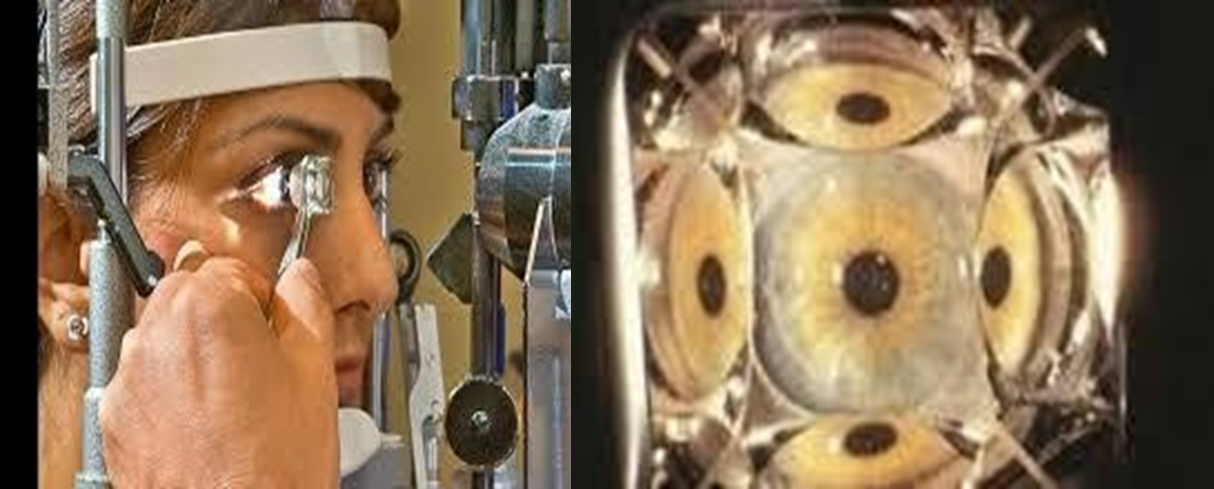
3- Gonioscopy: places a special mirrored lens into the eye to help the doctor see the angle between the cornea and iris.

Slide 29
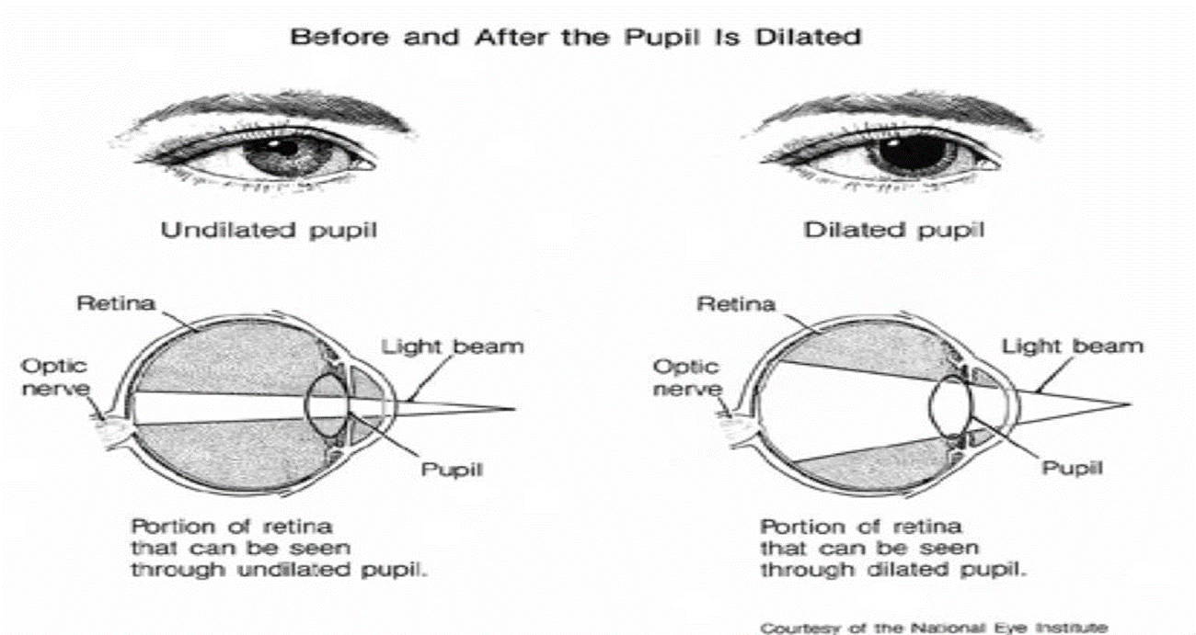
4- Visual field test: measures the peripheral (side) vision.
5- Dilated eye exam: uses light and magnifying glass to check for damage to the optic nerve.

Slide 30
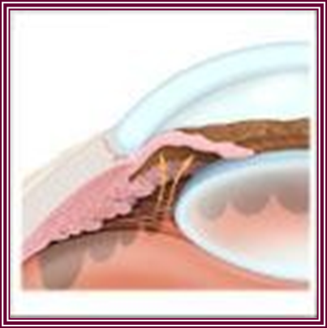
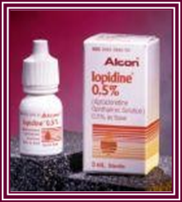
Treatment
The goal is to prevent further optic nerve damage
Maintain IOP within a range unlikely to cause damage
Pharmacologic therapy
Surgery
-Laser trabeculoplasty (angle-open)
-Laser iridotomy (angle-closure)
-Filtering procedures
-Trabeculectomy (bleb)
-Drainage implants or shunts

Slide 32
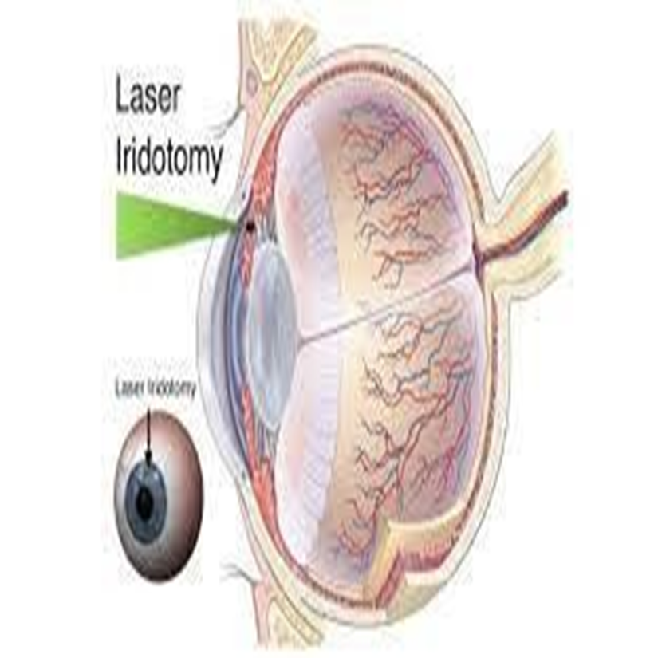

Slide 33
Nursing Diagnosis
Anxiety related to possible vision loss.
Disturbed sensory perception related to visual impairment.
Ineffective health maintenance related to knowledge deficit.
Risk for injury related to impaired vision.
Self-care deficit related to impaired vision.

Slide 34
Nursing Management
Patient education.
Focus on maintaining the therapeutic regimen for lifelong control of a chronic condition.
Emphasize the need for adherence to therapy and continued care to prevent further vision loss.
Provide education regarding the use and effects of medications.
Medications used for glaucoma may cause vision alterations and other side effects. The action and effects of medications need to be explained to promote compliance.
Provide support and interventions to aid the patient in adjusting to vision loss/potential vision loss.

Slide 35
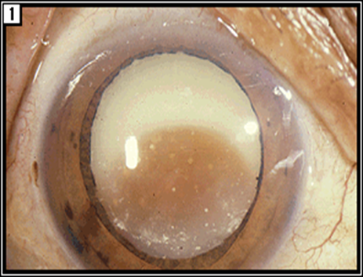
Cataracts
Opacity or cloudiness of the lens.
Increased incidence with aging; by age 80 more than half of all Americans have cataracts.
A leading cause of disability in the U.S.

Slide 36
Cataracts
A cataract is a clouding of the natural intraocular crystalline lens that focuses the light entering the eye onto the retina.
This cloudiness can cause a decrease in vision and may lead to eventual blindness if left untreated.
Cataracts often develop slowly and painlessly, so vision and lifestyle can be affected without a person realizing it.

Slide 37
It begins when proteins in the eye form clumps that prevent the lens from sending clear images to the retina.
The retina works by converting the light that comes through the lens into signals. It sends the signals to the optic nerve, which carries them to the brain.
It develops slowly and eventually interferes with the vision.
Cataracts are common in older people. Over half of the people in the United States have cataracts or have undergone cataract surgery by the time they’re 80 years old, according to the National Eye Institute Trusted.

Slide 40
Symptoms of Cataract
Blurred vision at distance or near (different types may affect distance greater than near or vice versa
Glare (halos or streaks around lights, difficulty seeing in the presence of bright lights).
Difficulty seeing in low light situations (including poor night vision).
Loss of contrast sensitivity.
Loss of ability to discern colors.
Increasing near-sightedness or change in refractive status.

Slide 41
Risk Factors
Diabetes or elevated blood sugar
Steroid use (oral, IV, or inhaled)
Ultraviolet exposure
Ocular diseases: Retinitis Pigmentosa, Uveitis
Ocular Trauma
Prior ocular surgery
Genetic predisposition
Radiation or chemo treatment

Slide 42
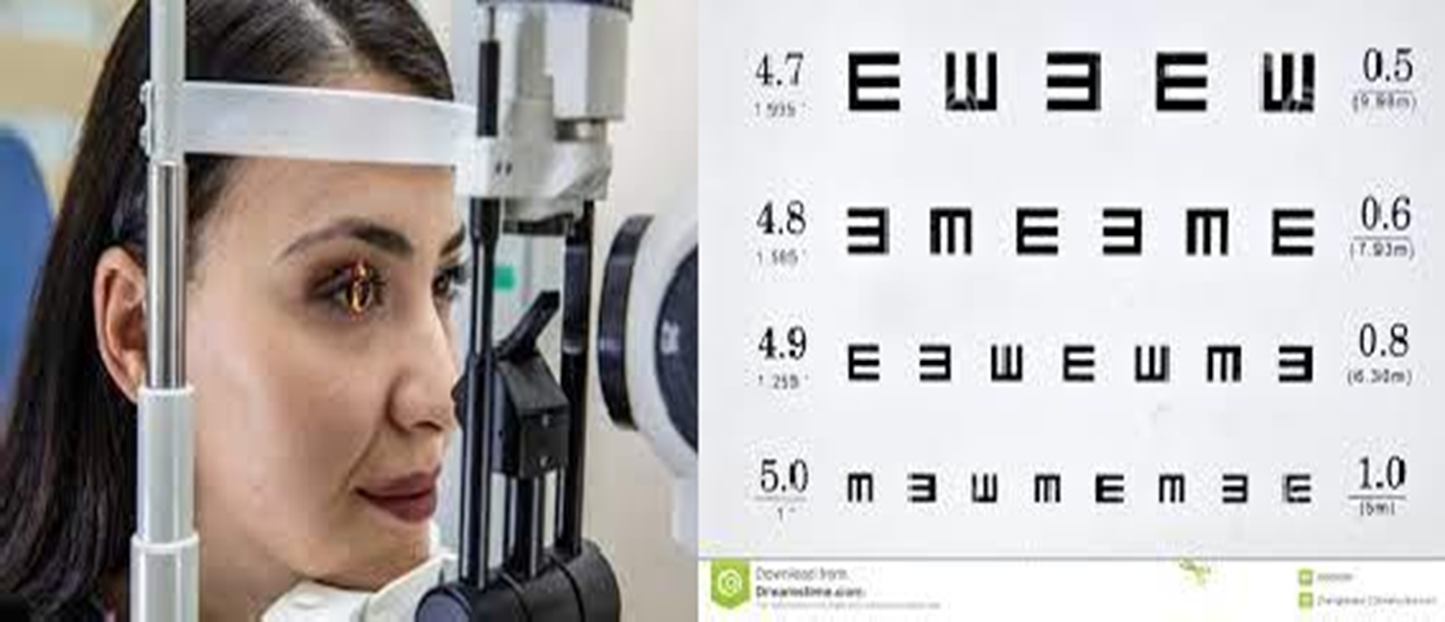
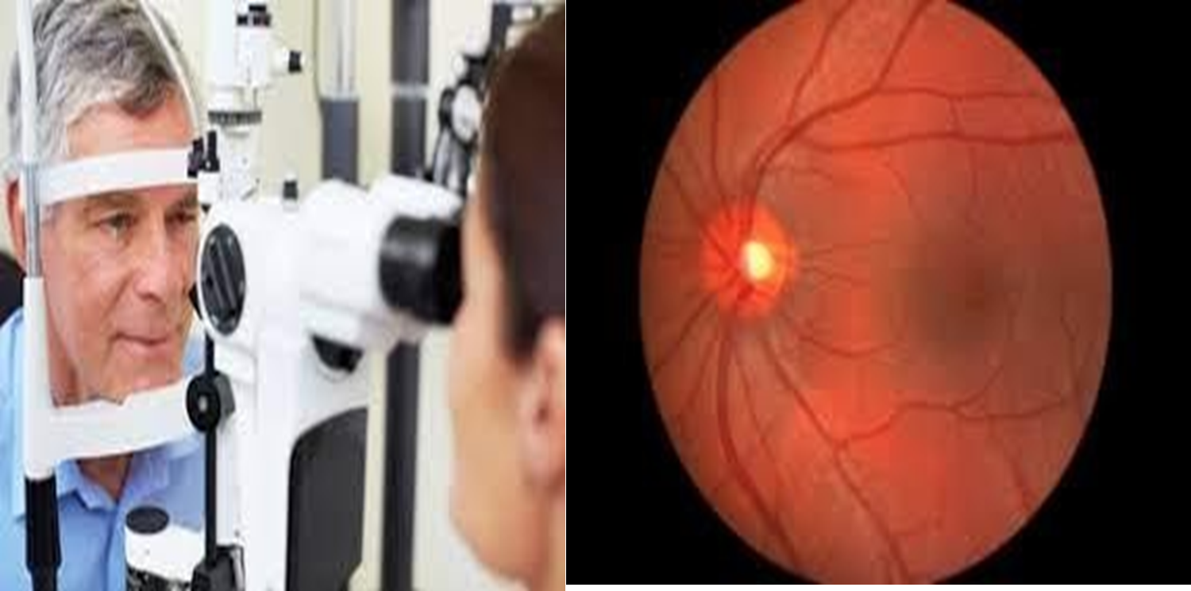
Diagnosis
1- Visual acuity test (eye chart exam) 2- Slit-lamp exam
3- Retinal exam

Slide 43
Surgical Management
If reduced vision does not interfere with normal activities, surgery is not needed.
Surgery is performed on an outpatient basis with local anesthesia.
Surgery usually takes less than 1 hour and patients are discharged soon afterward.
Complications are rare but may be significant.

Slide 44
Types of Cataract Surgery
Intracapsular cataract extraction (ICCE): removes the entire lens, rarely done today.
Extracapsular cataract extraction (ECCE): maintains the posterior capsule of the lens, reducing potential postoperative complications.
Phacoemuslification: an ECCE which uses an ultrasonic device to suction the lens out through a tube; the incision is smaller than with standard ECCE.
Lens replacement: after removal of the lens by ICCE or ECCE, the surgeon inserts an intraocular lens implant (IOL). This eliminates the need for aphakic lenses, however, the patient may still require glasses.

Slide 45
Nursing Diagnosis
Primary nursing diagnosis: (Sensory and perceptual alterations (visual) related to deceased visual acuity).
Other nursing diagnoses:
Anxiety
Deficient knowledge (diagnosis and treatment)
Risk for infection
Risk for injury

Slide 46
Nursing Management
Preoperative care
-Usual preoperative care for ambulatory surgery
-Dilating eye drops or other medications as ordered
Postoperative care
-Patient teaching
-Provide written and verbal instructions
-Instruct patient to call a physician immediately if vision changes; continuous flashing lights appear; redness, swelling, or pain increase; type and amount of drainage increases; or significant pain is not relieved by Paracetamol.

Slide 47
Nursing Management
Patient teaching.
-Eye surgery is most often done as an outpatient procedure so patient education is vital.
-Signs and symptoms of complications especially increased IOP and infection.
Promote comfort
The patient may need to lie in a special position with pneumatic retinopexy.

Slide 48
Summary
Glaucoma is a group of ocular conditions in which damage to the optic nerve is related to increased intraocular pressure (IOP) caused by congestion of the aqueous humor.
Glaucoma is the leading cause of blindness in adults in the U.S.
Glaucoma incidence increases with age.
Cataracts is opacity or cloudiness of the lens.
Cataracts increased incidence with aging; by age 80 more than half of all Americans have cataracts.
Cataracts is a leading cause of disability in the U.S.

Slide 49
Reference
Textbook of medical-surgical nursing Description: 14th edition. | Philadelphia : Wolters Kluwer, [2018], ISBN 9781496355157 (2-volume American edition).

Slide 50
Questions
1- What structure regulates the amount of light passing to the visual receptors of the eye? A) aqueous humor B) lens C) cornea D) iris
2- Farsightedness is more properly called ________. A) myopia B) hyperopia C) hyperopia D) presbyopia
3-Ordinarily, it is not possible to transplant tissues from one person to another, yet corneas can
be transplanted without tissue rejection. This is because the cornea ________.
A) is not a living tissue
B) has no nerve supply
C) has no blood supply
D) does not contain connective tissue

Slide 51
Questions
4- Conscious perception of vision probably reflects activity in the ________.
A) thalamus
B) occipital lobe of the cortex
C) chiasma
D) superior colliculus
5- The blind spot of the eye is ________.
A) where more rods than cones are found
B) where the macula lutea is located
C) where only cones occur
D) where the optic nerve leaves the eye
6- The eye muscle that elevates and turns the eye laterally is the ________.
A) lateral rectus
B) superior oblique
C) inferior oblique
D) medial rectus

Slide 52
Questions
7- What would happen to your pupils if it’s extremely bright outside
A) They would contract and become very small
B) They would dilate and become very large
C) Not affected
D) None of the above
8- A patient is exploring treatment options after being diagnosed with age-related cataracts that affect her
vision. What treatment is most likely to be used in this patients care?
A) Antioxidant supplements, vitamin C and E, beta-carotene, and selenium
B) Eyeglasses or magnifying lenses
C) Corticosteroid eye drops
D) Surgical intervention
9- Several changes occur in the eye with the aging process. The thickening and yellowing of the lens are referred to as:
a. Presbyopia
b. Floaters
c. Macular degeneration
d. Senile cataract

Slide 53
Questions
10- Visual acuity is assessed with
a. The Snellen eye chart
b. An ophthalmoscope
c. The Hirschberg test
d. The confrontation test

